Slide 1
College of Western Idaho SWDV 210 Introduction to Server Side Programming
Week 2 Day 3 Lab

Slide 2
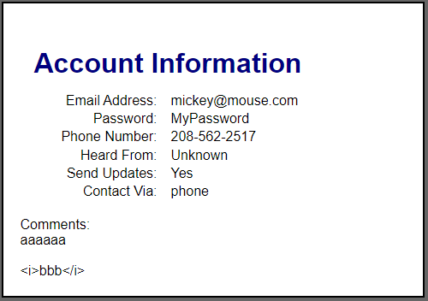
Day 3 Lab
Complete Exercises 7-1 on page 231
Post the link to your enhanced Account Signup application in BB under Daily Labs, Wk2Day3 & submit
Sample output:

